Slide 1
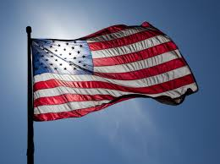
U.S Symbols Song!

Slide 2
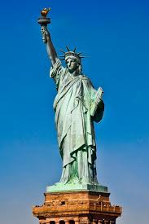
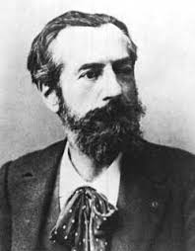
We’ve got lots of symbols
To show America is special
Learn them so you will know
Our country is a masterpiece!
Statue of Liberty you can see it
In New York City!
Bart Holdi from France gave this gift that is so pretty

Slide 3
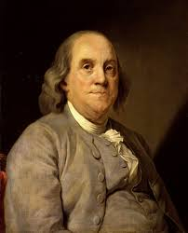
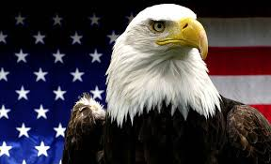
The bald (eagle) is brown and white and gold
Ben Franklin (wanted) a turkey I am told.
But Bald (eagles) stand for freedom and for strength!
Their wingspan (is) almost 8 feet in length!

Slide 4
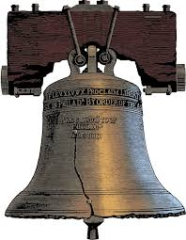
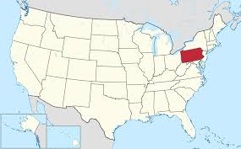
Liberty Bell in Pennsylvania (ooh!)
Is another symbol for freedom (ooh!)
It’s made of copper but has a crack
So if you visit don’t give it a whack!

Slide 5
And last our flag with stars and stripes
13 stripes and 50 stars
And do you know what colors are ours?
We are red white and blue!
[[Dance break]]
Let’s dance for the red white and blue!
[[Dance break]]
Dance for red white and blue!
Dance for red white and blue!
Dance for red white and blue!
You know the symbols too!
Hey! Hey! Hey! Hey!

