Slide 1
Polygon Song

Slide 2
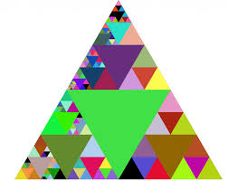
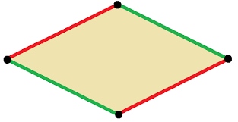
I’d like to tell you about polygons
They are shapes with all straight sides
You’ve got triangles and squares
You’ve got rhombuses and hexagons
Just know that circles are not there.

Slide 3
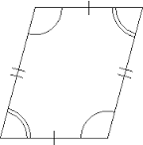
I want to talk parallelograms!
They’ve got 2 pairs of parallel sides
If you don’t know parallel
Look at train tracks and just yell
Those lines will never ever cross

Slide 4
Quadrangles have 4 angles
Quadrilaterals have 4 sides
So a rhombus or a square
That rectangle over there
Not triangles with only 3

Slide 5
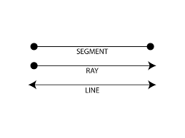
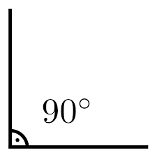
Rights angles are the paper corners
Show me with your arms right now
There’s also lines that keep on going
Line segments that have to end
And rays that always go one way!

