Slide 1
MATTER SONGS!
SOLIDS
LIQUIDS
GASES

Slide 2
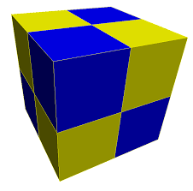
SOLIDS Tune: Hound Dog
A solid’s a solid.
It doesn’t change shape.
It can’t move around;
It stays in one place.
A solid’s a solid.
It doesn’t change shape!

Slide 3
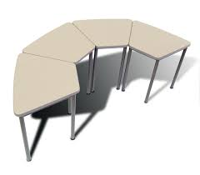
Your desk is a solid.
And so is your chair!
Just look in your classroom- Wow! They’re everywhere!
Your desk is a solid.
And so is your chair!

Slide 4
LIQUIDS Tune: Rollin in the Deep
A liquid moves smoothly, We say that it flows
From one place to another– How quickly it goes!
We know that most liquids are easy to see.
With no shape of their own,
They’re not like you and me!
Start video at 1:02, start singing at 1:08

Slide 5
GASES Tune: We Will Rock You
Air is a gas, you can’t see it that’s true
But often we feel it in things that we do
It keeps up a kite, air fills up a bubble
Without it to breathe, we would be in big trouble
Air is a gas! Air is a gas!

