Slide 1
Continents!

Slide 2
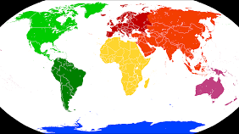
Africa, Asia, Europe and Australia
North and South America
And the last, Antarctica!

